Slide 1

Summer Undergraduate Research Award 2024
Shear Thickening Fluids
Prediction of viscosity of Non-Newtonian fluids at different shear rates and temperatures using artificial neural network models
Applicant: Lakshya Kumar (2022TT12183)
Abhiraj Kumar Koslia (2022TT12187)
Department: Dept. of Textile & Fibre Engg.
Facilitator: Prof. Abhijit Majumdar
Department: Dept. of Textile & Fibre Engg.

Slide 2
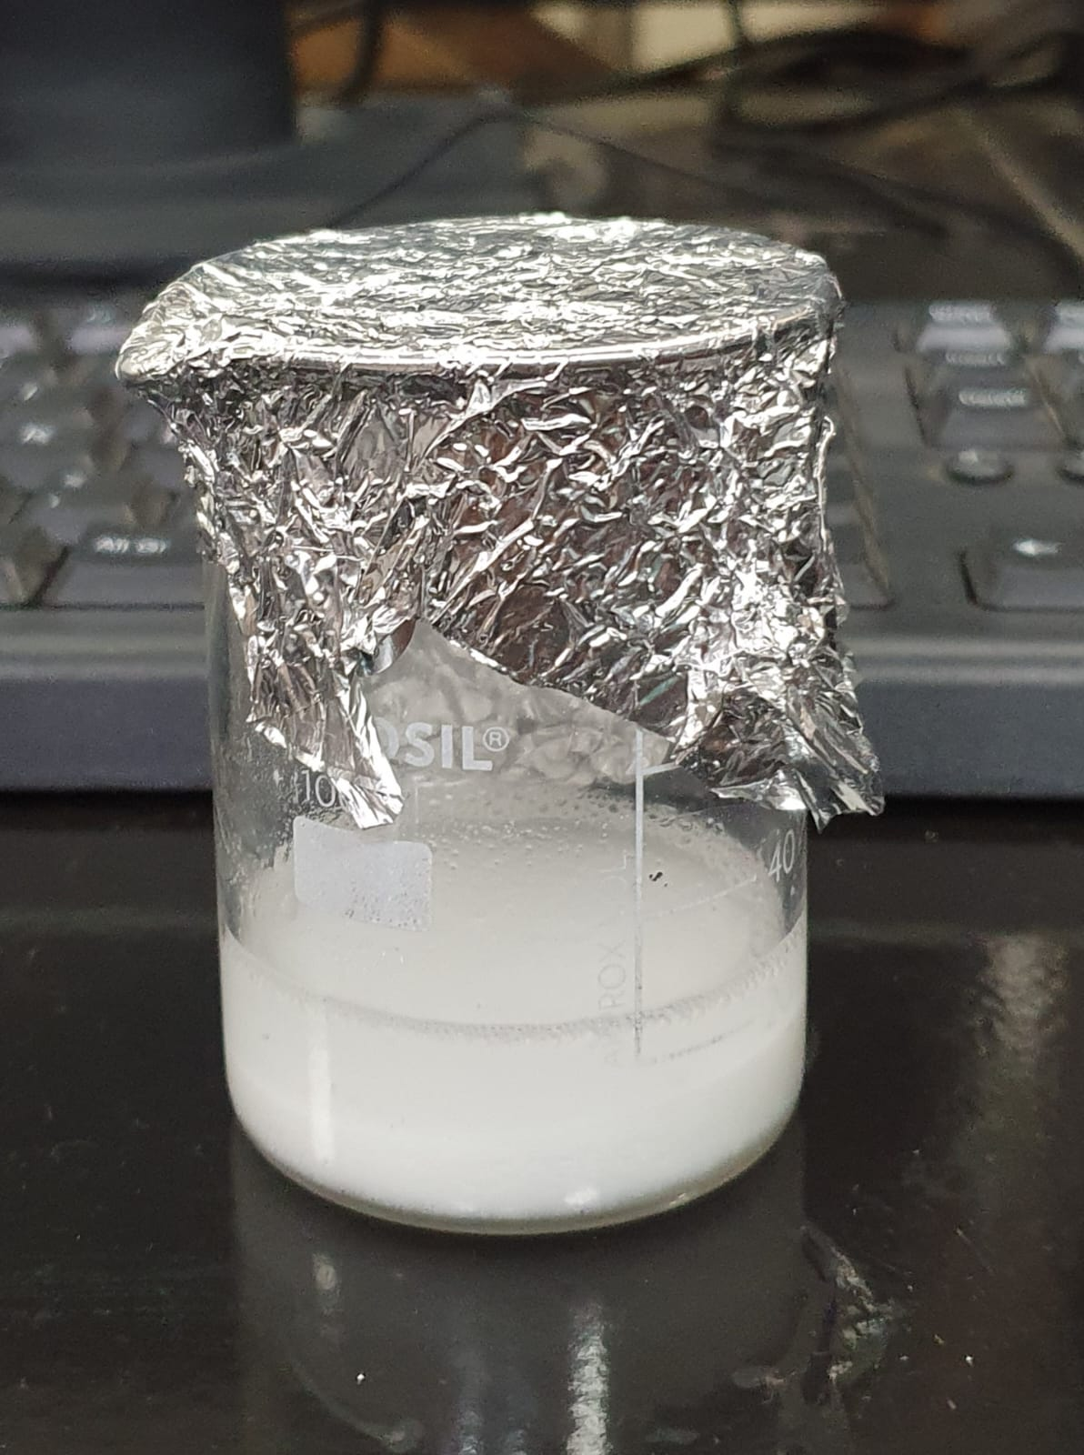
Table of Contents
1
Introduction
2
Objectives
3
Methodology
4
Future Scope
5
Timeline
6
Budget
7
Conclusion

Slide 3
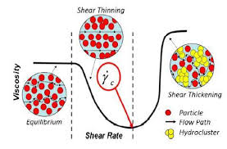
01.
Initially, ballistic textiles relied solely on high-performance fibers, such as aramids (e.g., Kevlar) and ultra-high molecular weight polyethylene (UHMWPE), to provide protection against impact threats. While these fibers offer exceptional strength and stiffness, their performance in dissipating the kinetic energy of projectiles or impacts was limited.
To enhance the impact resistance and energy dissipation capabilities of ballistic textiles, researchers explored the integration of shear thickening fluids (STFs) with these high-performance fiber fabrics.
Introduction
Schematics of Shear Thinning and Shear Thickening Effect

Slide 4
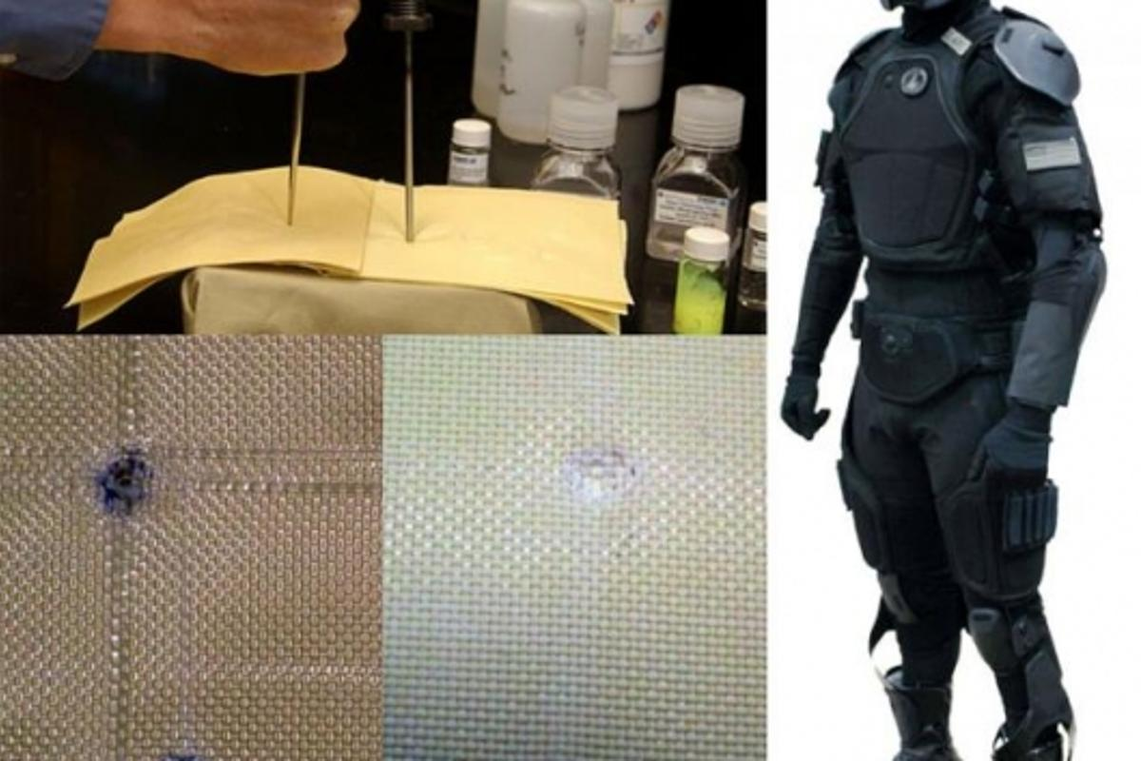
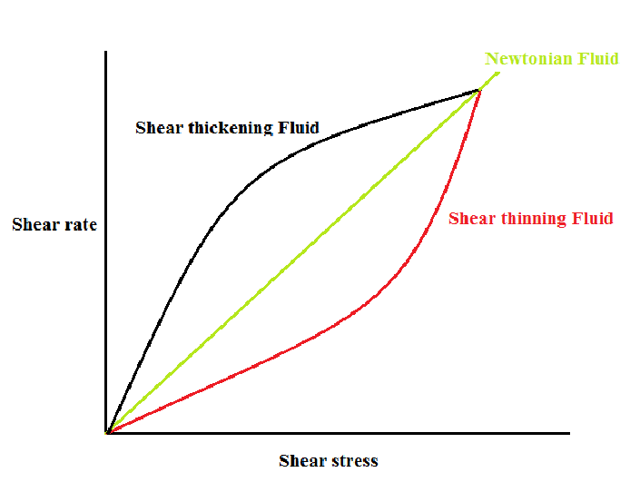
02.
The main objective of our project is to analyze the changes in viscosity of a non-Newtonian fluid due to changing parameters such as particle size and temperature.
→ Synthesis of Shear Thickening Fluids (STFs)
→ Perform rheological studies on the prepared STFs
→ Data Driven Insights can be taken by analyzing the data collected and building a predictive model using curve-fitting techniques and artificial neural networks.
→ Identify and implement suitable changes to current models to address their shortcomings on the given dataset by evaluating several configurations of the networks.
Objectives
(self generated)

Slide 5
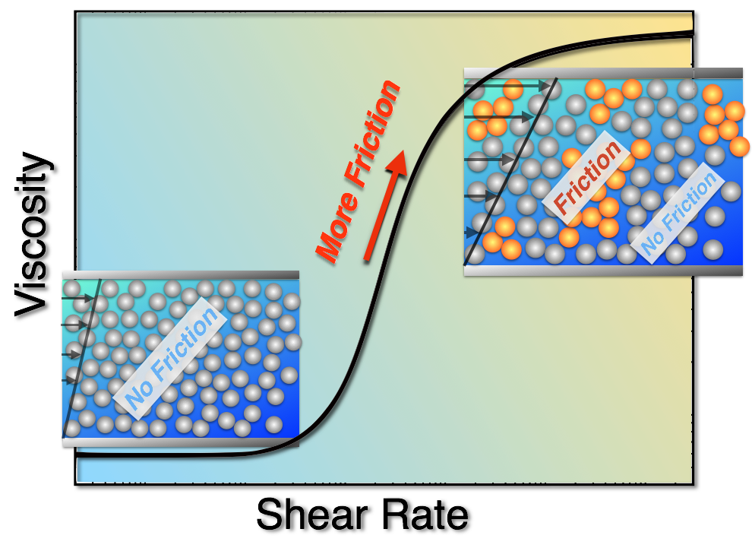
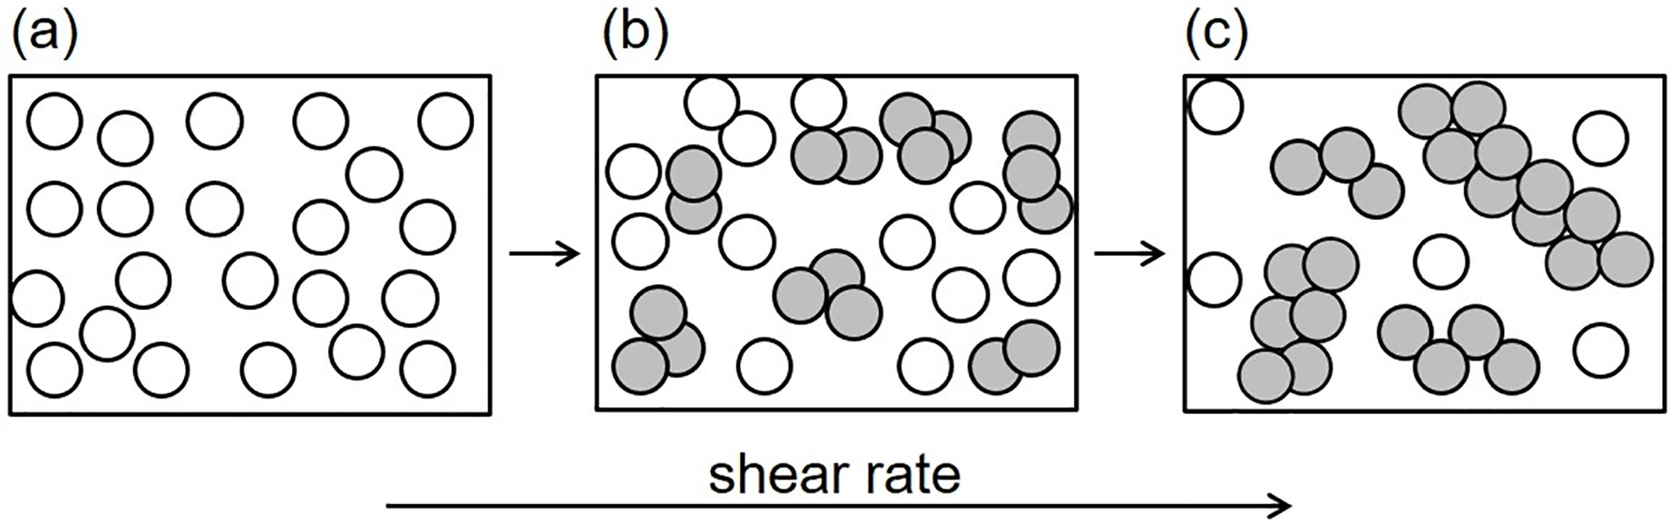
What are STFs?
This remarkable property arises from the formation of hydro clusters or jamming clusters of particles suspended in the fluid, which resist flow under high shear. STFs have garnered significant interest due to their potential applications in developing impact-resistant materials, such as body armor, protective gear, and energy-dissipating systems.
Shear thickening fluids (STFs) are a unique class of non-Newtonian fluids that exhibit an extraordinary transition from liquid-like to solid-like behavior when subjected to high shear rates or impact forces.

Slide 6
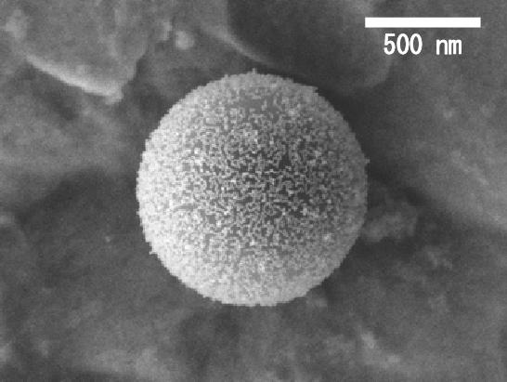
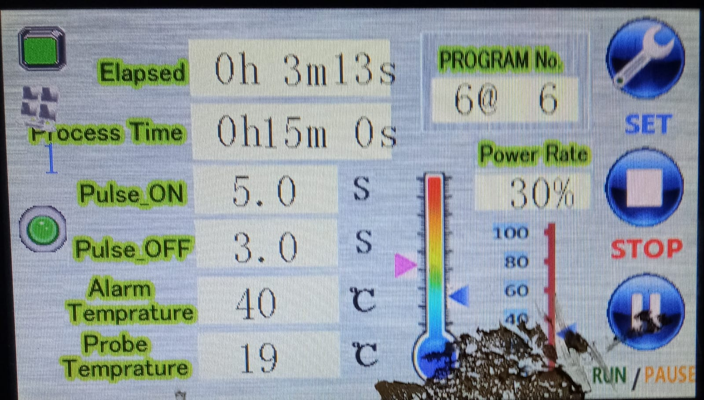
03.
Methodology

Slide 7

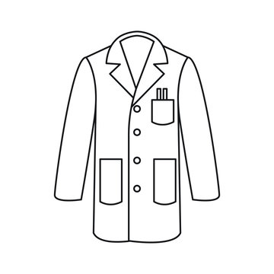
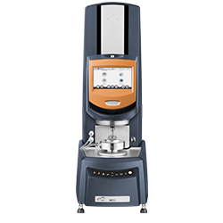


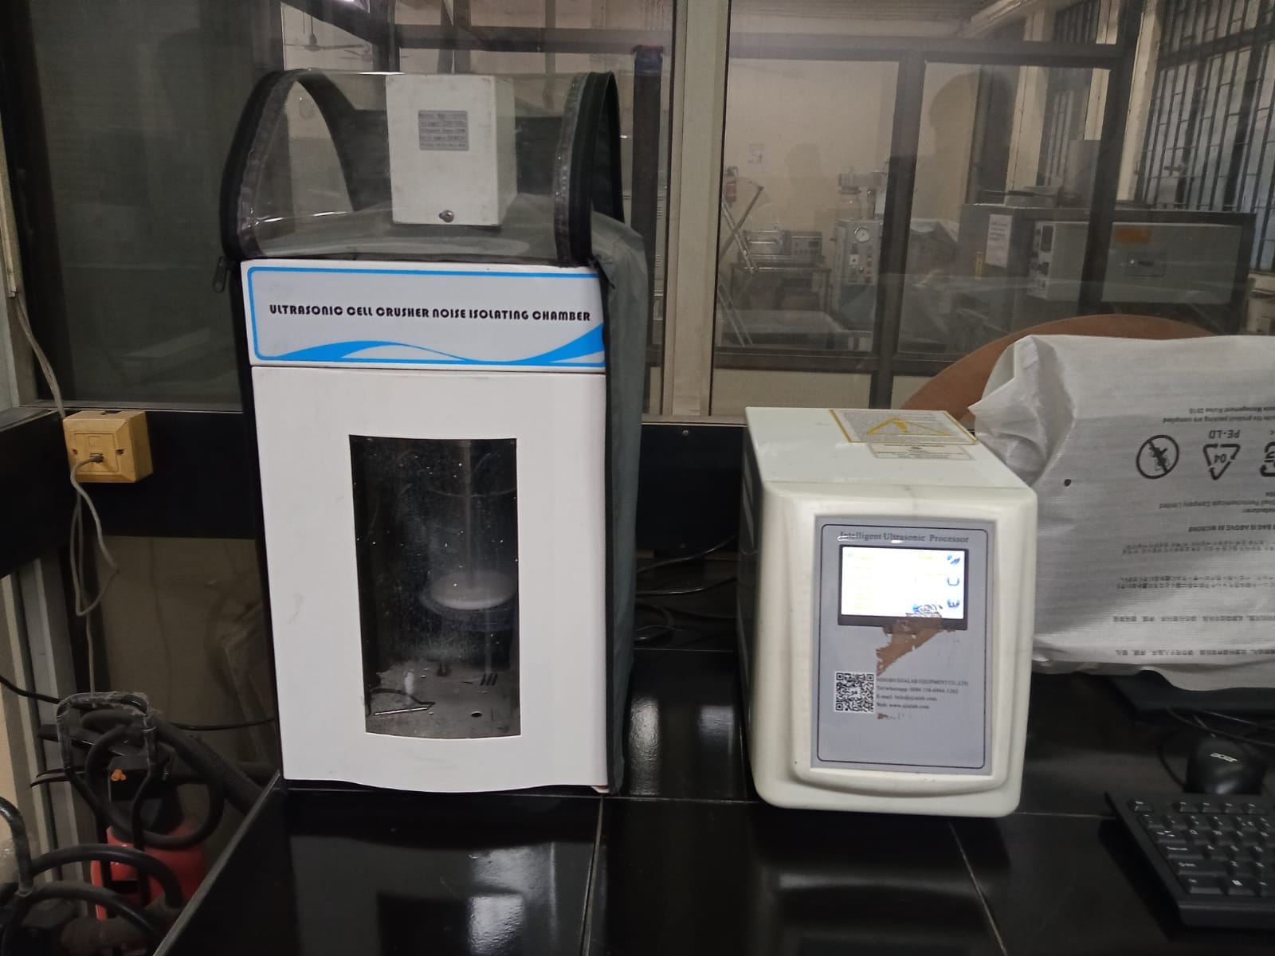
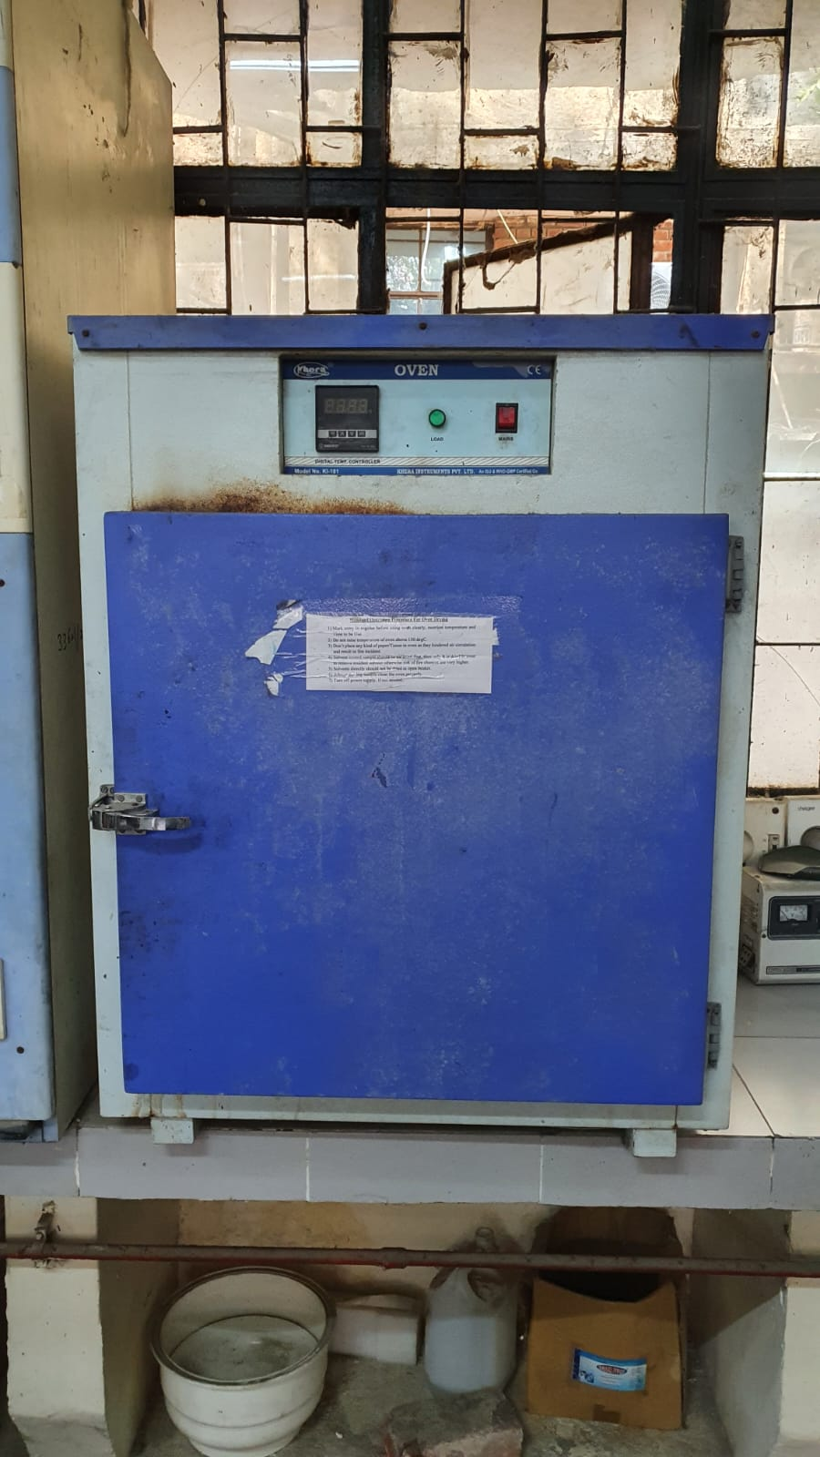


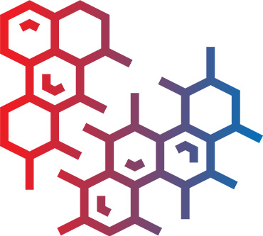
Experimental aspect:
3.1 Experimental Design
Particle sizes
Temperatures
Equipments Needed
100 nm
500 nm
20˚C
40 ˚C
300 nm
30 ˚C
3.2 Sample Preparation
Weigh and Measure
Disperse in the PEG
Ultrasonicator to ensure proper mixing
Mixture allowed to rest in Oven

Slide 8
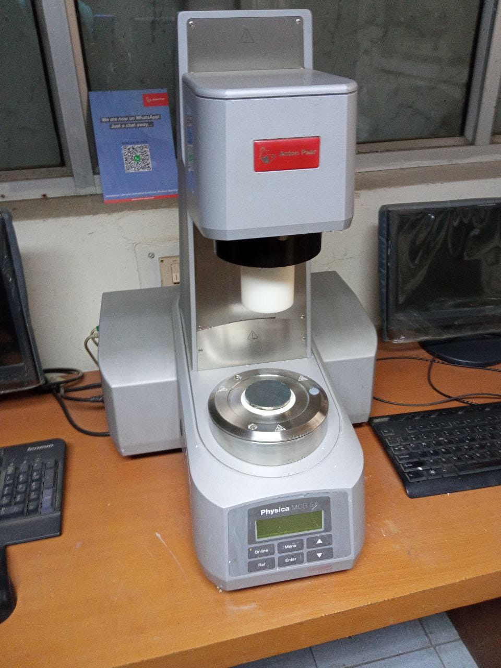
3.3 Rheology Testing
Using the prepared samples, we will conduct rheology testing on the rheometer.
Viscosity measurements will be taken at various shear rates (controlled by the rheometer settings) at the specified temperatures.
Data collected will include shear rate, temperature, and the corresponding viscosity values for each sample.
3.4 Data Collection
The viscosity data obtained from the rheology tests will serve as the training dataset for the artificial neural network models.
Each data point will consist of:
Input: Shear rate, temperature, nanoparticle size
Output: Viscosity

Slide 9


Computational aspect:
3.5 Artificial Neural Network (ANN) Model Development
We will design an ANN model using software like TensorFlow or PyTorch.
The input layer will have nodes for shear rate, temperature, and nanoparticle size.
The output layer will predict the viscosity.

Slide 10


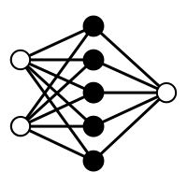
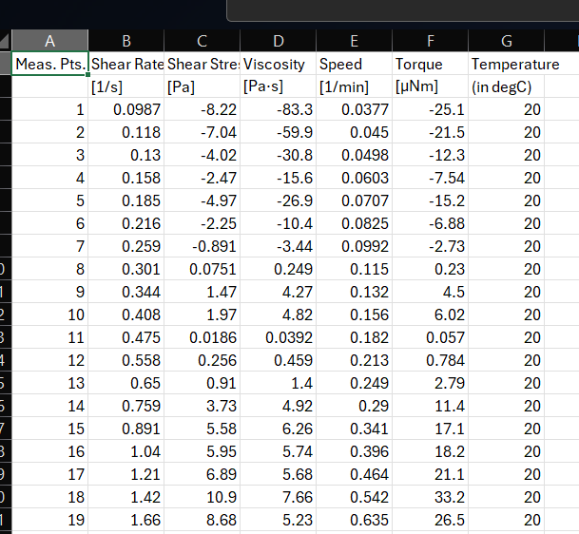

3.6 Model Evaluation
MODEL
TEST DATASET
OPTIMIZATION OF CODE AND MINIMIZING ERRORS

Slide 11
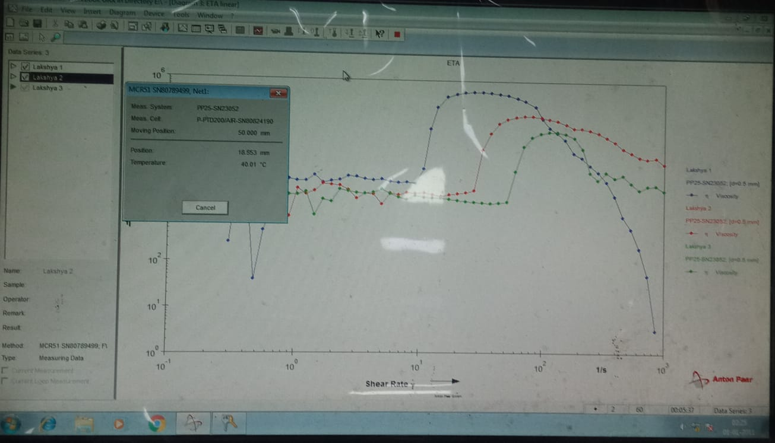
3.7 Prediction & Analysis of Viscosity
With a trained and validated ANN model, we will input new data (shear rate, temperature, nanoparticle size) to predict viscosity.
The model will output the estimated viscosity values for the given conditions.
We will analyze the predicted viscosity values and compare them to actual measurements to validate the model's accuracy.
Any discrepancies will be investigated to improve the model if necessary.
This approach aims to utilize experimental data to train an ANN model that can effectively predict the viscosity of Non-Newtonian fluids under varying conditions. It involves careful sample preparation, thorough rheology testing, model development, training, validation, and evaluation to ensure reliable predictions.

Slide 12
04.
Protective equipment: STFs can be integrated into fabrics for ballistic testing and understanding their applications like anti-stab armor and shin guards, where their shear thickening behavior enhances impact and penetration resistance.
Investigating the temperature dependence of STF rheology is crucial as it can guide the selection of appropriate particle concentration and size for specific applications across different environmental conditions.
Motion sensors and lithium battery electrolytes: STFs have been explored as motion sensors due to their viscosity changes in response to applied forces, and as potential electrolytes in lithium-ion batteries to enhance safety and performance.
Vibration damping and impact absorption: The energy dissipation capabilities of STFs make them suitable for use as buffer materials in vibration damping and impact absorption applications.
Future Scope

Slide 13
05.
Experimental aspect
Sample Preparations
Rheology Testing
Data Gathering
1st Month
Literature review
Vary parameters
Record observations
Collect data
Computational aspect
Build Model
Train Model
Efficiency Testing
2nd Month
Literature review
Build primary model
Train on training set
Check efficiency using testing dataset.
Timeline

Slide 14
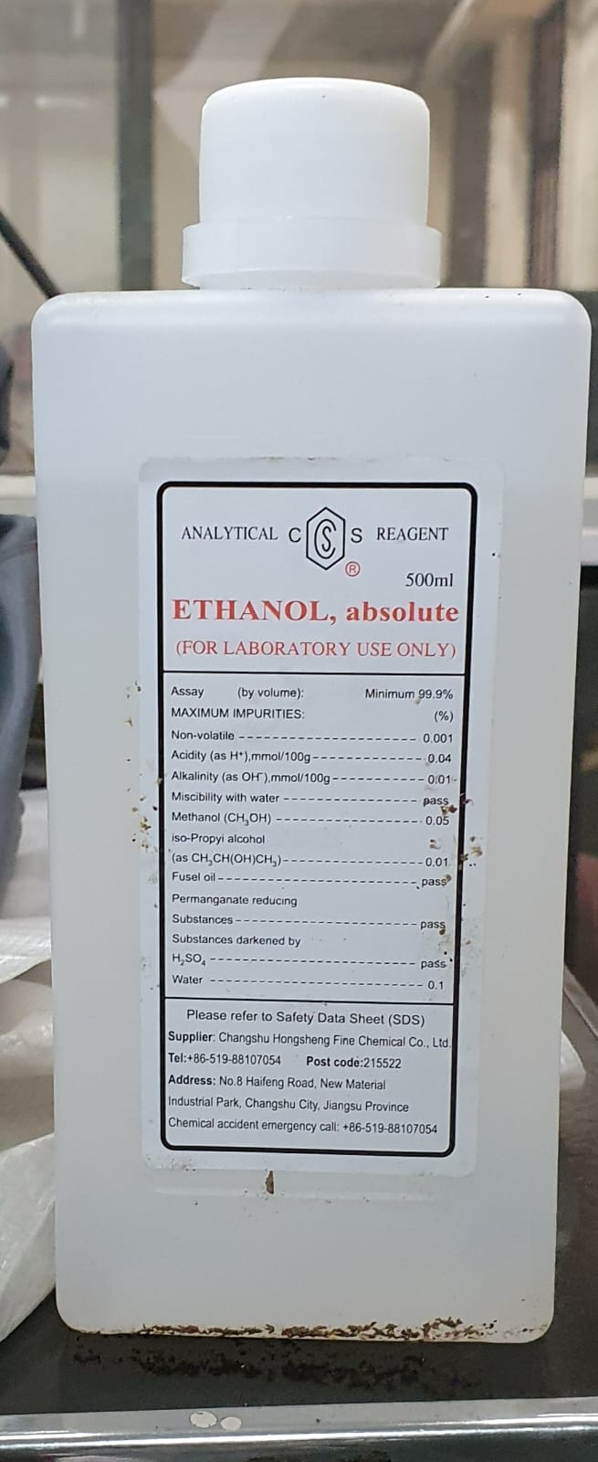
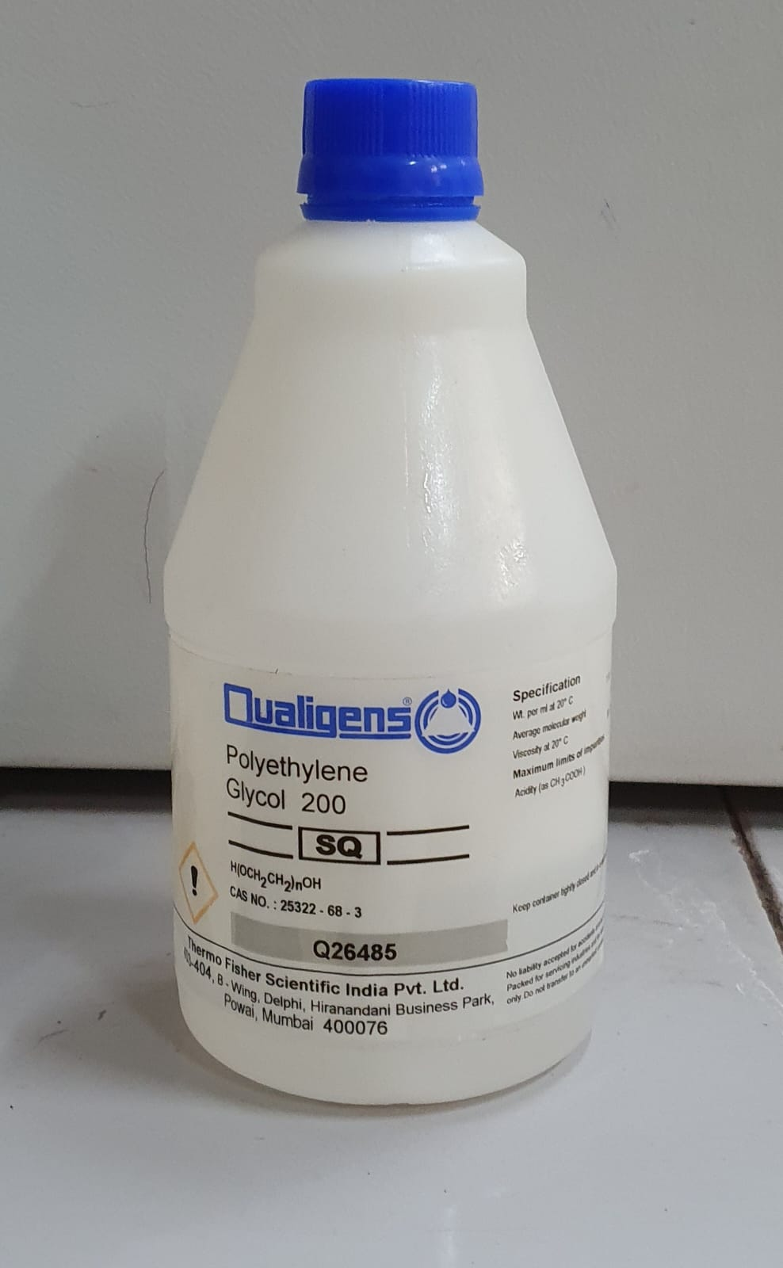
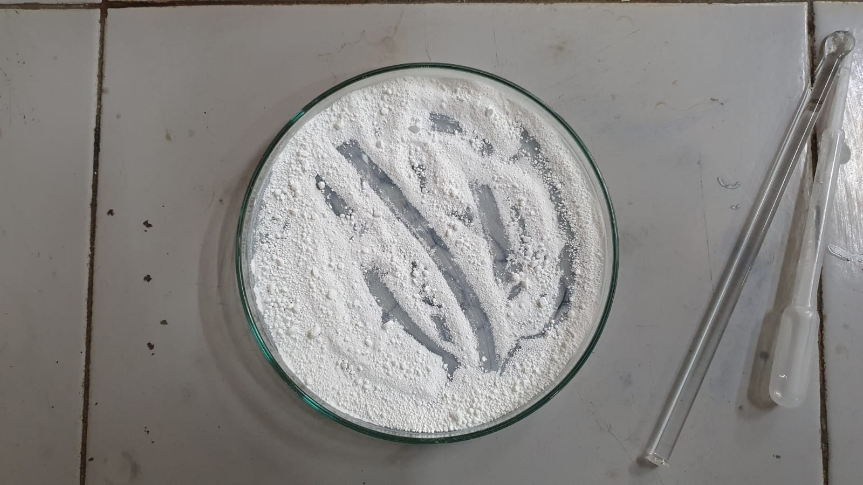
06.
We will require access to the following resources for the project:
Silica Particles of sizes : → 100 nm → 300 nm → 500 nm
Polyethylene glycol (PEG) of 200 mol. wt.
Ethanol
Equipments/Machines required:
→ Ultrasonicator → Rheometer → Oven → General lab equipments like gloves, beakers, stirrers etc
We will need approximately Rs. 25,000 and high priority access to above mentioned resources present in the laboratories.
Budget

Slide 15
07.
In conclusion, in my project on shear thickening fluids (STFs), we shall:
Investigating the impact of particle size and temperature on shear thickening fluids (STFs).
Synthesizing STF samples using silica nanoparticles of varying sizes (100 nm, 300 nm, and 500 nm).
Conducting rheological studies to measure viscosity changes under different shear rates and temperatures (10°C, 20°C, and 30°C).
Developing an artificial neural network (ANN) model to predict STF viscosity based on input parameters: shear rate, temperature, and particle size.
Utilizing both computational (ANN) and experimental (rheology) approaches.
Aiming to gain insights into STFs' complex viscosity behavior and understand how particle size and temperature affect shear thickening.
Enabling effective application of STFs in impact-resistant materials, protective gear, energy dissipation systems, and motion sensors.
Conclusion

Slide 16
References
F.J. Galindo-Rosales,F.J. Rubio-Hernández, and A. Sevilla, (2011) ‘An apparent viscosity function for shear thickening fluids’, Journal of Non-Newtonian Fluid Mechanics, 166(5–6), pp. 321–325. doi:10.1016/j.jnnfm.2011.01.001.
Mohammad Hemmat Esfe,Seyfolah Saedodin,Nima Sina,Masoud Afrand,Sara Rostami, (2015) ‘Designing an artificial neural network to predict thermal conductivity and dynamic viscosity of ferromagnetic nanofluid’, International Communications in Heat and Mass Transfer, 68, pp. 50–57. doi:10.1016/j.icheatmasstransfer.2015.06.013.
Marziyeh Ramzi , Mahdi Kashaninejad , Fakhreddin Salehi , Ali Reza Sadeghi Mahoonak, Seyed Mohammad Ali Razavi (2015) ‘Modeling of rheological behavior of honey using genetic algorithm–artificial neural network and adaptive neuro-fuzzy inference system’, Food Bioscience, 9, pp. 60–67. doi:10.1016/j.fbio.2014.12.001.
Zarei, M. and Aalaie, J. (2020) ‘Application of shear thickening fluids in material development’, Journal of Materials Research and Technology, 9(5), pp. 10411–10433. doi:10.1016/j.jmrt.2020.07.049.
Sanchi Arora, Animesh Laha, Abhijit Majumdar and Bhupendra Singh Butola (2017) ‘Prediction of rheology of shear thickening fluids using phenomenological and artificial neural network models’, Korea-Australia Rheology Journal, 29(3), pp. 185–193. doi:10.1007/s13367-017-0019-x.

Slide 17
THANK
YOU!

